Slide 1
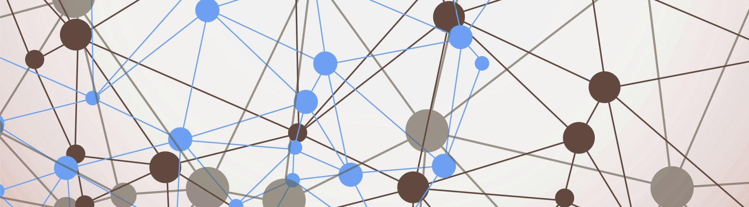
Machine Learning with Python

Slide 2
Python
Python is one of the most popular programming language for machine learning.
We will use Iris clustering and classification as running examples.

Slide 3
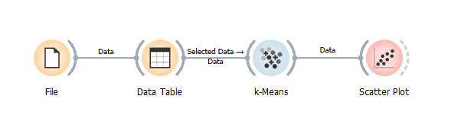
Clustering

Slide 4

Import Libraries

Slide 5
Load Data

Slide 6
View Data (Optional)

Slide 7

Clustering with k-Means

Slide 8
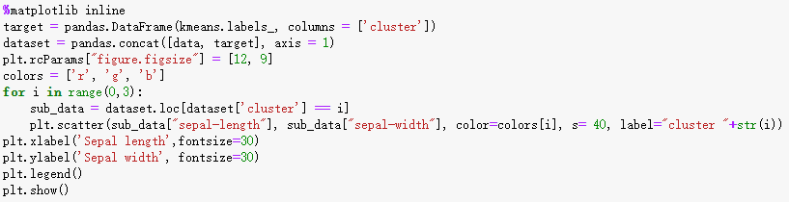
Plot

Slide 9
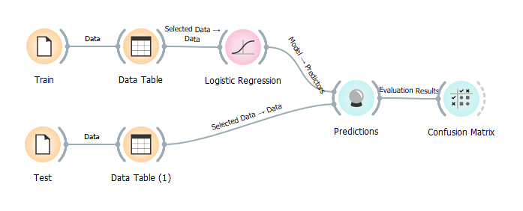
Classification

Slide 10

Import Libraries

Slide 11
Load Data

Slide 12
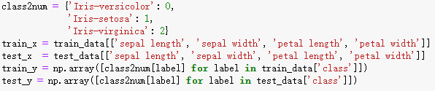
Preprocess

Slide 13

Train Logistic Regression Model

Slide 14
Prediction

Slide 15

Evaluation

Slide 16
Now your turn!

